Slide 1

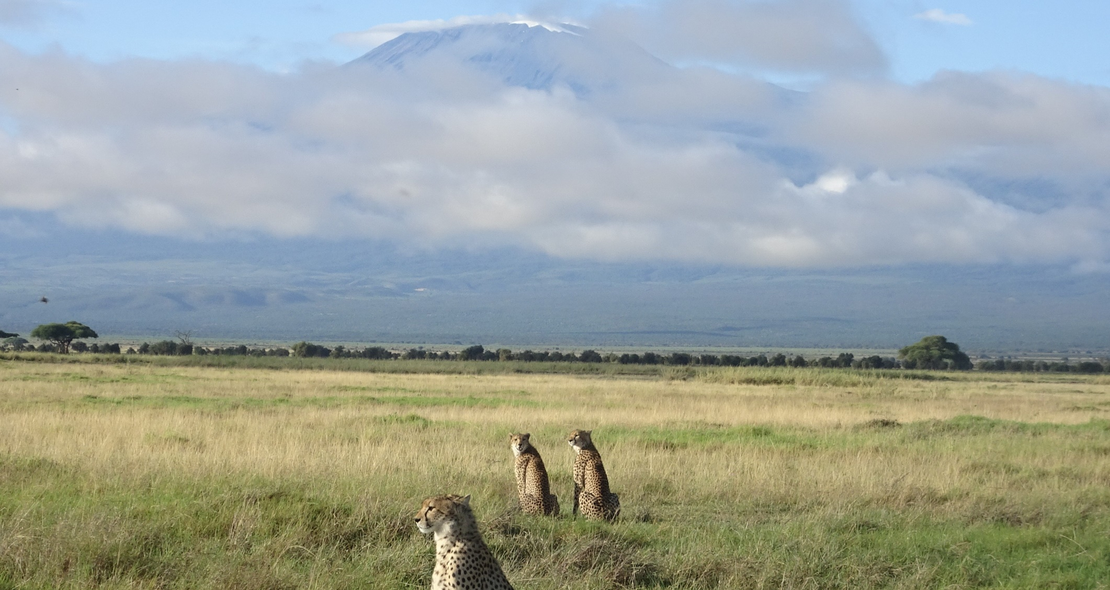
IUCN and the Post 2020 Agenda
– with a focus on area based conservation
Stephen Woodley, Vice-Chair for Science and Biodiversity, WCPA-IUCN

Slide 2

Context for a Post 2020 Conservation Agenda
  General failure to achieve the Aichi Targets
  Global human population – currently 7.8 Billion, projected at 9.7 Billion by 2050
  Global C02 at 412 PPM and emissions rising
  Conclusions of the IPBES report:
  Nature and its vital contributions to people, which together embody biodiversity and ecosystem functions and services, are deteriorating worldwide
    75 per cent of the Earth’s land surface is significantly altered
    66 per cent of the ocean area is experiencing increasing cumulative impacts
    over 85 per cent of wetlands (by area) have been lost
  Nature is essential for human existence and good quality of life. Most of nature’s contributions to people are not fully replaceable, and some are irreplaceable.
    IUCN Ocean warming and Ocean acidification reports
  Human actions threaten more species with global extinction now than ever before.
    Extinction rates are 1000 time background and future rates could be 10,000 higher
    1 million species threatened with extinction
  In the past 50 years, the human population has doubled, the global economy has grown nearly fourfold and global trade has grown tenfold, together driving up the demand for energy and materials.
    Decline of 70 % in global wildlife populations since 1970

Slide 3
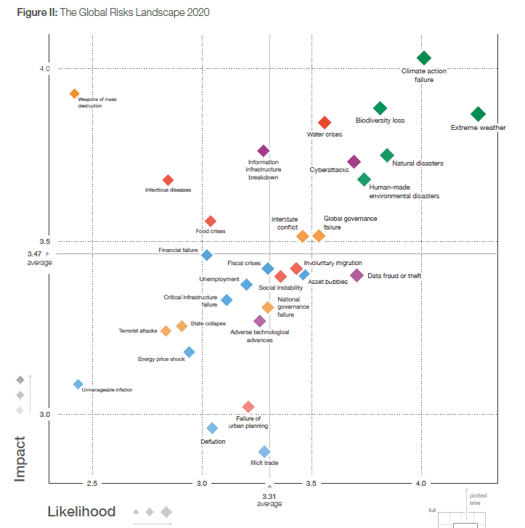
The Global Risks Report 2020
– World Economic Forum

Slide 4


CBD - Open-Ended Working Group Process
Party Led – Co-Chairs from Canada* and Uganda - decision 14/34
OEWG meetings – Nairobi (Aug, 2019) , Kunming (Feb, 2020) and Cali (July, 2020)
Thematic Workshops – 1)Restoration; 2) Marine and Coastal; 3) Area-Based Conservation; 4) Resource Mobilization; 5) Transparent Implementation, 6) Monitoring, Reporting and Review; 7) Capacity Building and Technical and Scientific Co-operation; 8) Youth Summit;
SBSTTA 23, 24, SBI3
COP 15 in Kunming

Slide 5
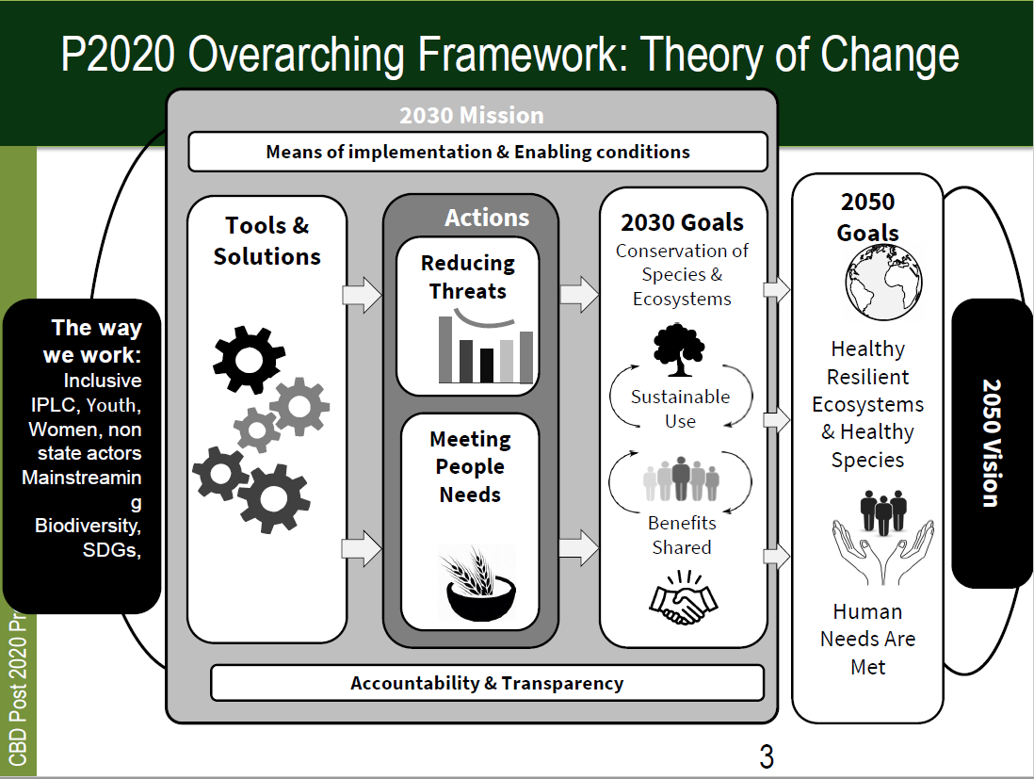

Slide 6
ARCHITECTURE OF THE GLOBAL BIODIVERSITY FRAMEWORK – Zero Draft
Mission - “By 2050, biodiversity is valued, conserved, restored and wisely used, maintaining ecosystem services, sustaining a healthy planet and delivering benefits essential for all people.”
The 2030 Mission : “To take urgent action across society to put biodiversity on a path to recovery for the benefit of planet and people”.
5 goals – long term by 2030 and then 2050
  Ecosystem - No net loss by 2030 in the area and integrity of freshwater, marine and terrestrial ecosystems, and increases of at least [20%] by 2050, ensuring ecosystem resilience;
  Species - The percentage of species threatened with extinction is reduced by [X%] and the abundance of species has increased on average by [X%] by 2030 and by [X%] by 2050;
  Genes - Genetic diversity is maintained or enhanced on average by 2030, and for [90%] of species by 2050;
  People - Nature provides benefits to people contributing to:
    Improvements in nutrition for at least [X million] people by 2030 and [Y million] by 2050;
    Improvements in sustainable access to safe and drinkable water for at least [X million] people, by 2030 and [Y million] by 2050;
    Improvements in resilience to natural disasters for at least [X million] people by 2030 and [Y million] by 2050;
    At least [30%] of efforts to achieve the targets of the Paris Agreement in 2030 and 2050.
  Benefits - The benefits, shared fairly and equitably, from the use of genetic resources and associated traditional knowledge have increased by [X] by 2030 and reached [X] by 2050.

Slide 7
Selected 2030 Action Targets – from the 20
Retain and restore freshwater, marine and terrestrial ecosystems, increasing by at least [50%] the land and sea area under comprehensive spatial planning addressing land/sea use change, achieving by 2030 a net increase in area, connectivity and integrity and retaining existing intact areas and wilderness.
Protect sites of particular importance for biodiversity through protected areas and other effective area-based conservation measures, by 2030 covering at least [60%] of such sites and at least [30%] of land and sea areas with at least [10%] under strict protection.
Control all pathways for the introduction of invasive alien species, achieving by 2030 a [50%] reduction in the rate of new introductions, and eradicate or control invasive alien species to eliminate or reduce their impacts by 2030 in at least [50%] of priority sites.
Reduce by 2030 pollution from excess nutrients, biocides, plastic waste and other sources by at least [50%].
Ensure by 2030 that the harvesting, trade and use of wild species, is legal and at sustainable levels.
****Contribute to climate change mitigation and adaptation and disaster risk reduction through nature-based solutions providing by 2030 [about 30%] [at least XXX MT CO₂=] of the mitigation effort needed to achieve the goals of the Paris Agreement, complementing stringent emission reductions, and avoiding negative impacts on biodiversity and food security.

Slide 8

IUCN in the Post 2020 Space
IUCN Council Task Force – consolidated views
SSC Post-2020 Biodiversity Targets Task Force (https://research.ncl.ac.uk/biodiversitypost2020/)
Halt overall species’ population declines by 2030 such that they have recovered by 2050, prevent extinctions of all species, and improve the status of at least 30% of species by 2030 and 100% by 2050
WCPA Beyond the Aichi Targets Task Force
(https://naturebeyond2020.com/)
Secretariat – Jane Smart and Trevor Sandwith- IUCN is an active player within CBD - IUCN Views on the Post 2020 Targets
(https://www.iucn.org/files/iucn-views-post-2020-global-biodiversity-framework-content-and-scope-submission-december-15-2018)

Slide 9

WCPA Task Force on Beyond the Aichi Targets
(https://naturebeyond2020.com/)
Harvey Locke – Chair
Alison Woodley – Canada Lead
Peer Reviewed Papers:
  A Review of Evidence for Area-based Conservation Targets for the Post-2020 Global Biodiversity Framework
    Strong support for 30-70% protection
  A Global Survey of Conservation Scientists
    81 Countries – enormous support for large conservation targets, retention of wilderness, KBAs, connectivity
  Three Global Conditions for Biodiversity Conservation and Sustainable Use: an implementation framework

Slide 10
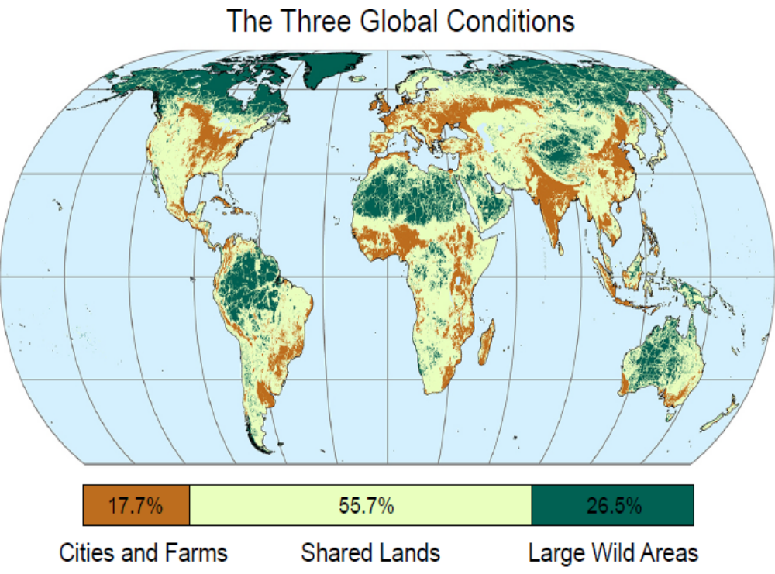
C1: Secure endangered species, protect all remaining primary ecosystem fragments, maintain pollinators, increase ecological restoration. Mainstream sustainable practises, reduction and urban planning for compact cities
C2: Establish “ecologically representative and well-connected systems of protected areas… integrated into the wider landscape”; restore and maintain ecological processes and viable populations of native species (increase area protected to 25 to 75% of ecoregion). Practise sustainable resource extraction outside
C3: Retain overall ecological integrity and associated global processes such as carbon storage and rainfall generation, fluvial flows and large migrations; prevent further fragmentation allowing only rare nodes of intense industrial development enveloped in a largely wild matrix. Remove and restore anomalies. Control invasive species where needed. Secure Indigenous knowledge and livelihoods.

Slide 11
Discussion:
What is missing?
  Protected area effectiveness, equity, representativeness
Is it bold enough given the global crises?
How will Canada advocate at international gatherings that countries around the world set a goal of 30 per cent conservation by 2030?

