Slide 1
ADVANCING NATURE-BASED CLIMATE SOLUTIONS
CCIUCN AGM
JAN. 28, 2020
Risa Smith
Chair, Protected Areas Climate Change Specialist Group

Slide 2
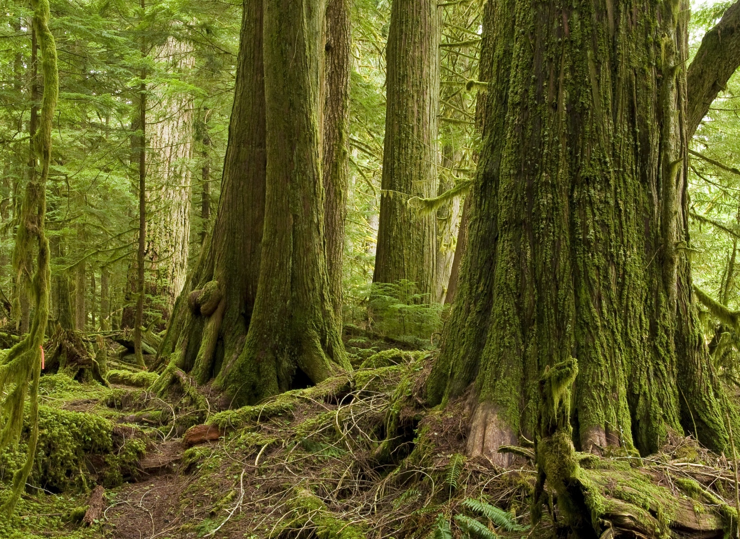
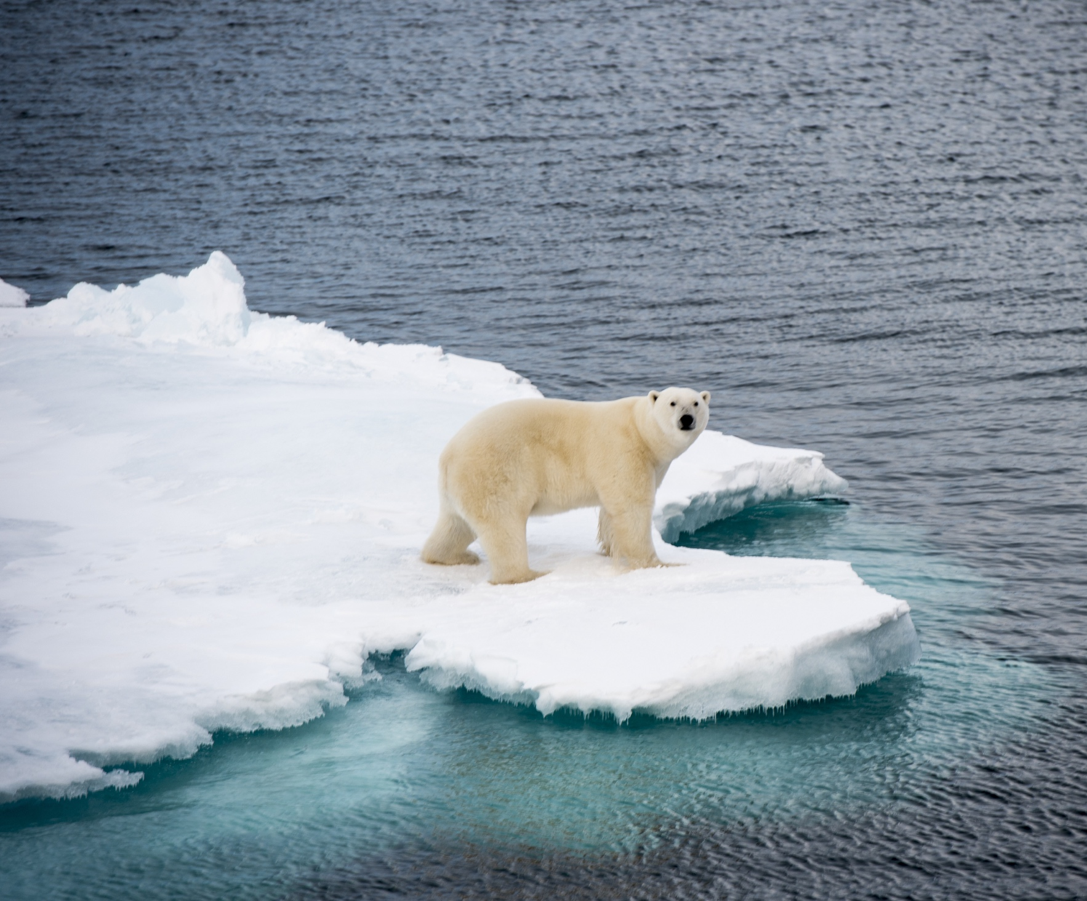
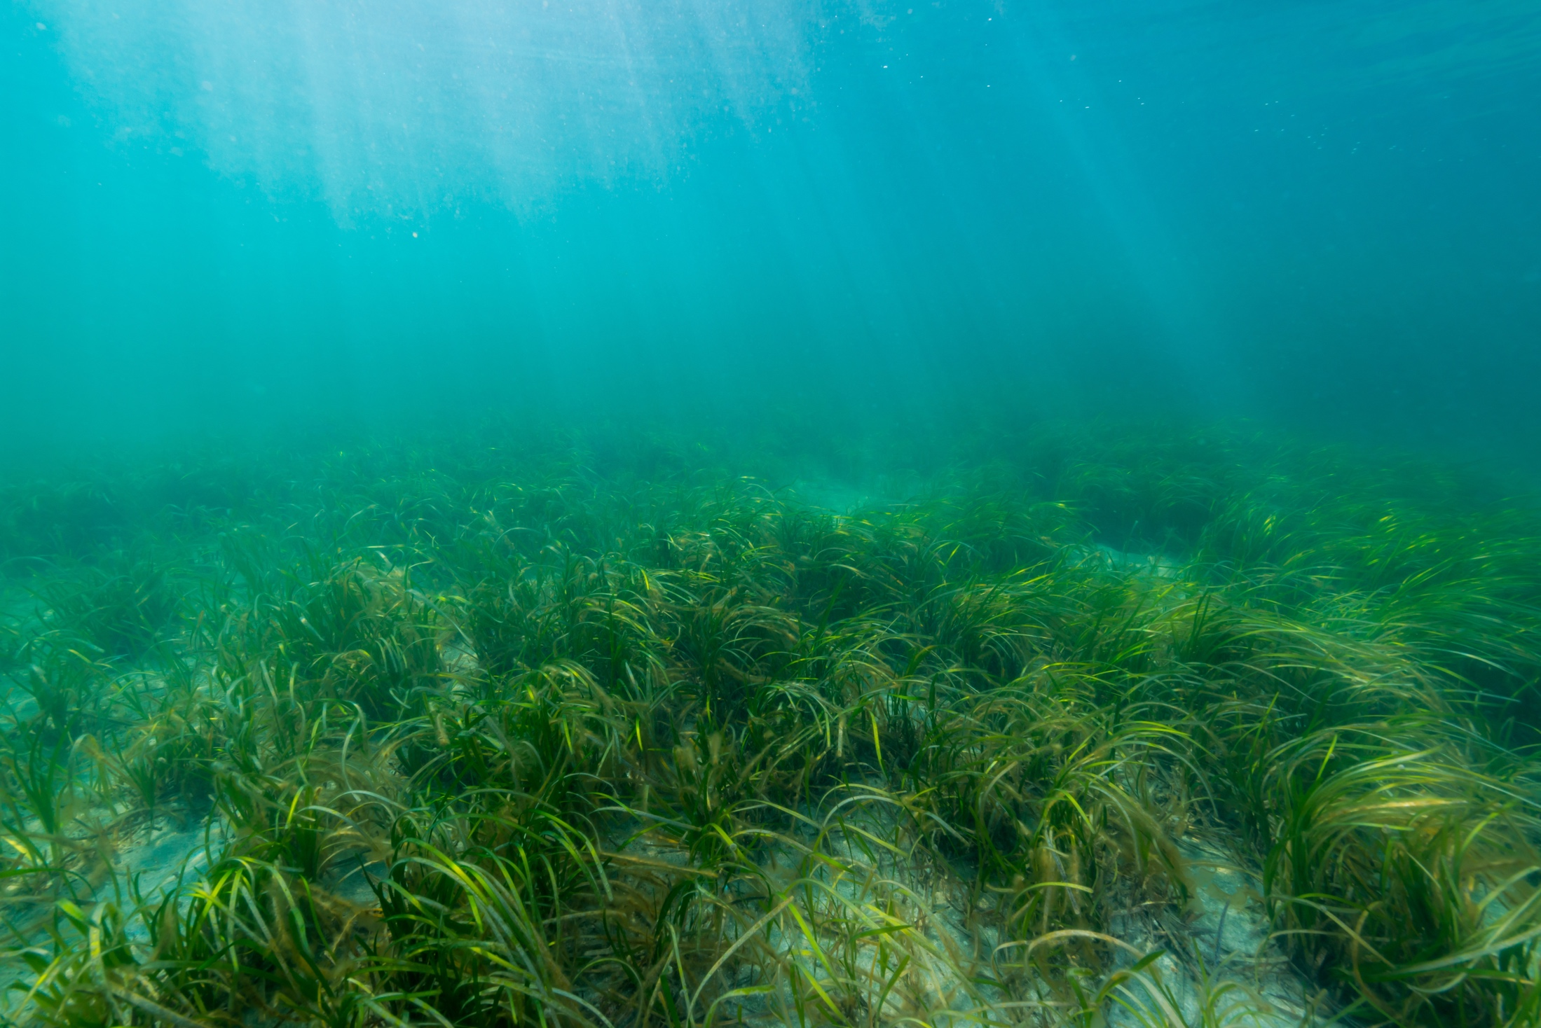
^{The Context}
Nature-Based Solutions: State of Play
^{Canada’s Emerging Approach}
^{Ecosystem Contributions}

Slide 3
The Context
DEFINING NATURE-BASED SOLUTIONS
“Sustainable practices that harness the natural world” Nature Editorial Jan. 2017
“Implementation of solutions to societal problems based on nature.” Nesshöver et al 2017
“Actions to protect, sustainably manage and restore natural or modified ecosystems that address societal challenges….: “ IUCN

Slide 4
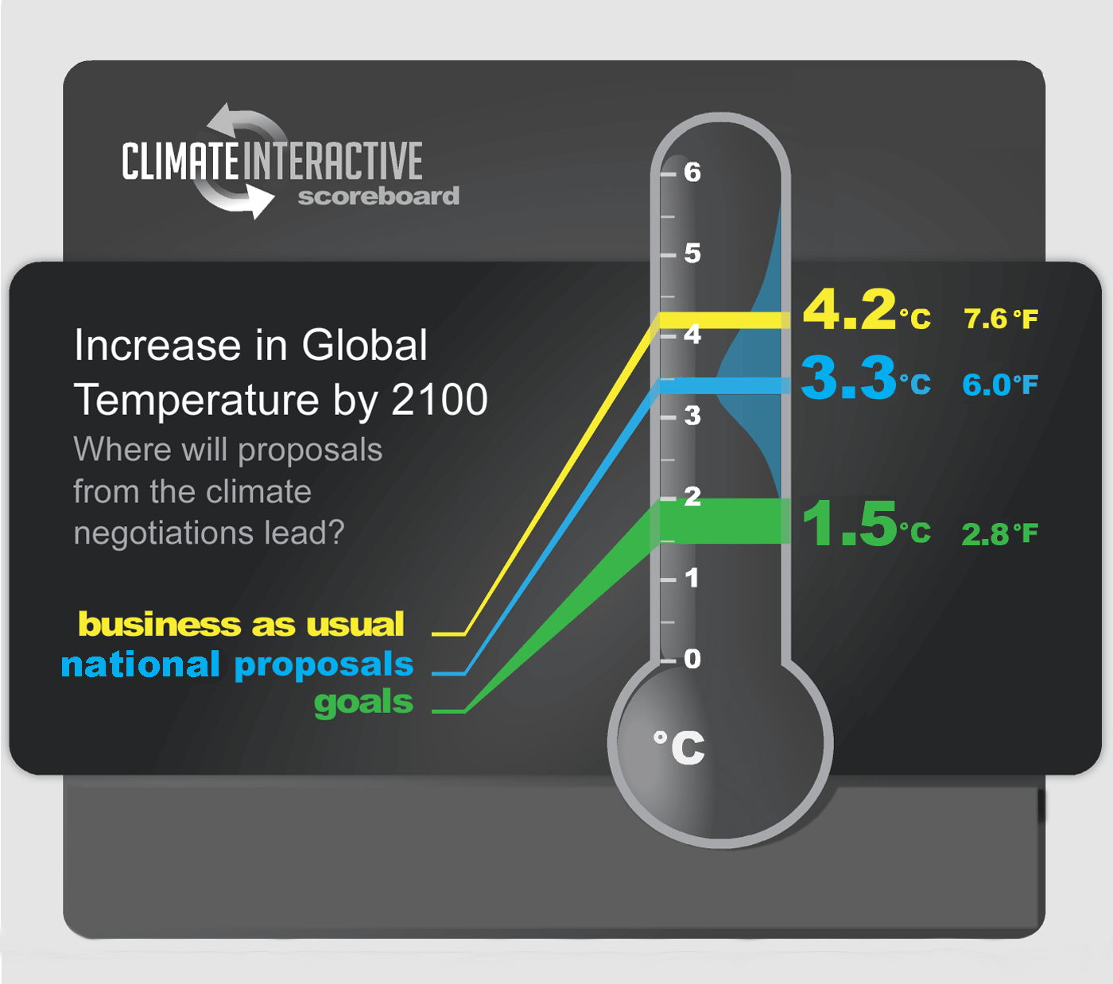
PARIS CLIMATE AGREEMENT
Limit global warming to “well below 2⁰C” above preindustrial levels and to “pursue efforts to limit it to 1.5⁰ C” by end of the century
1.0⁰C
2018

Slide 5
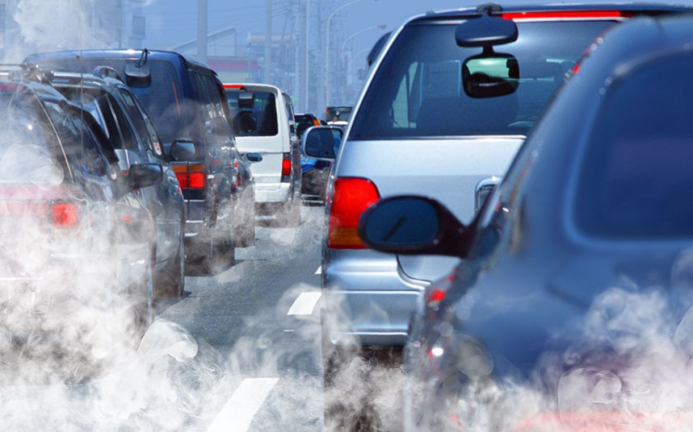
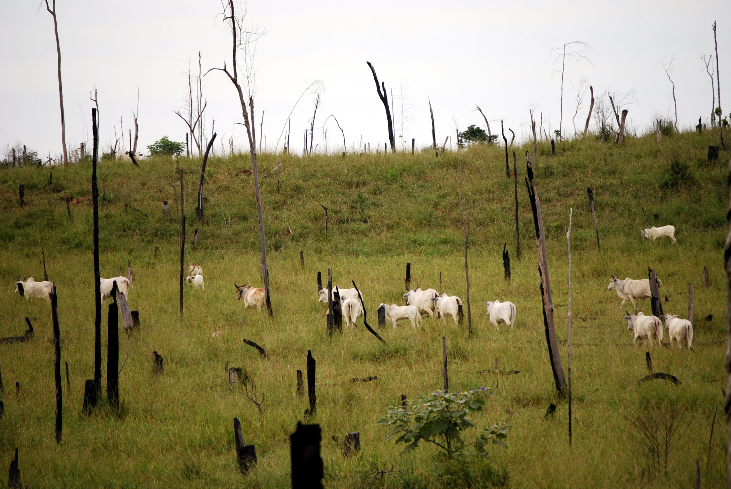
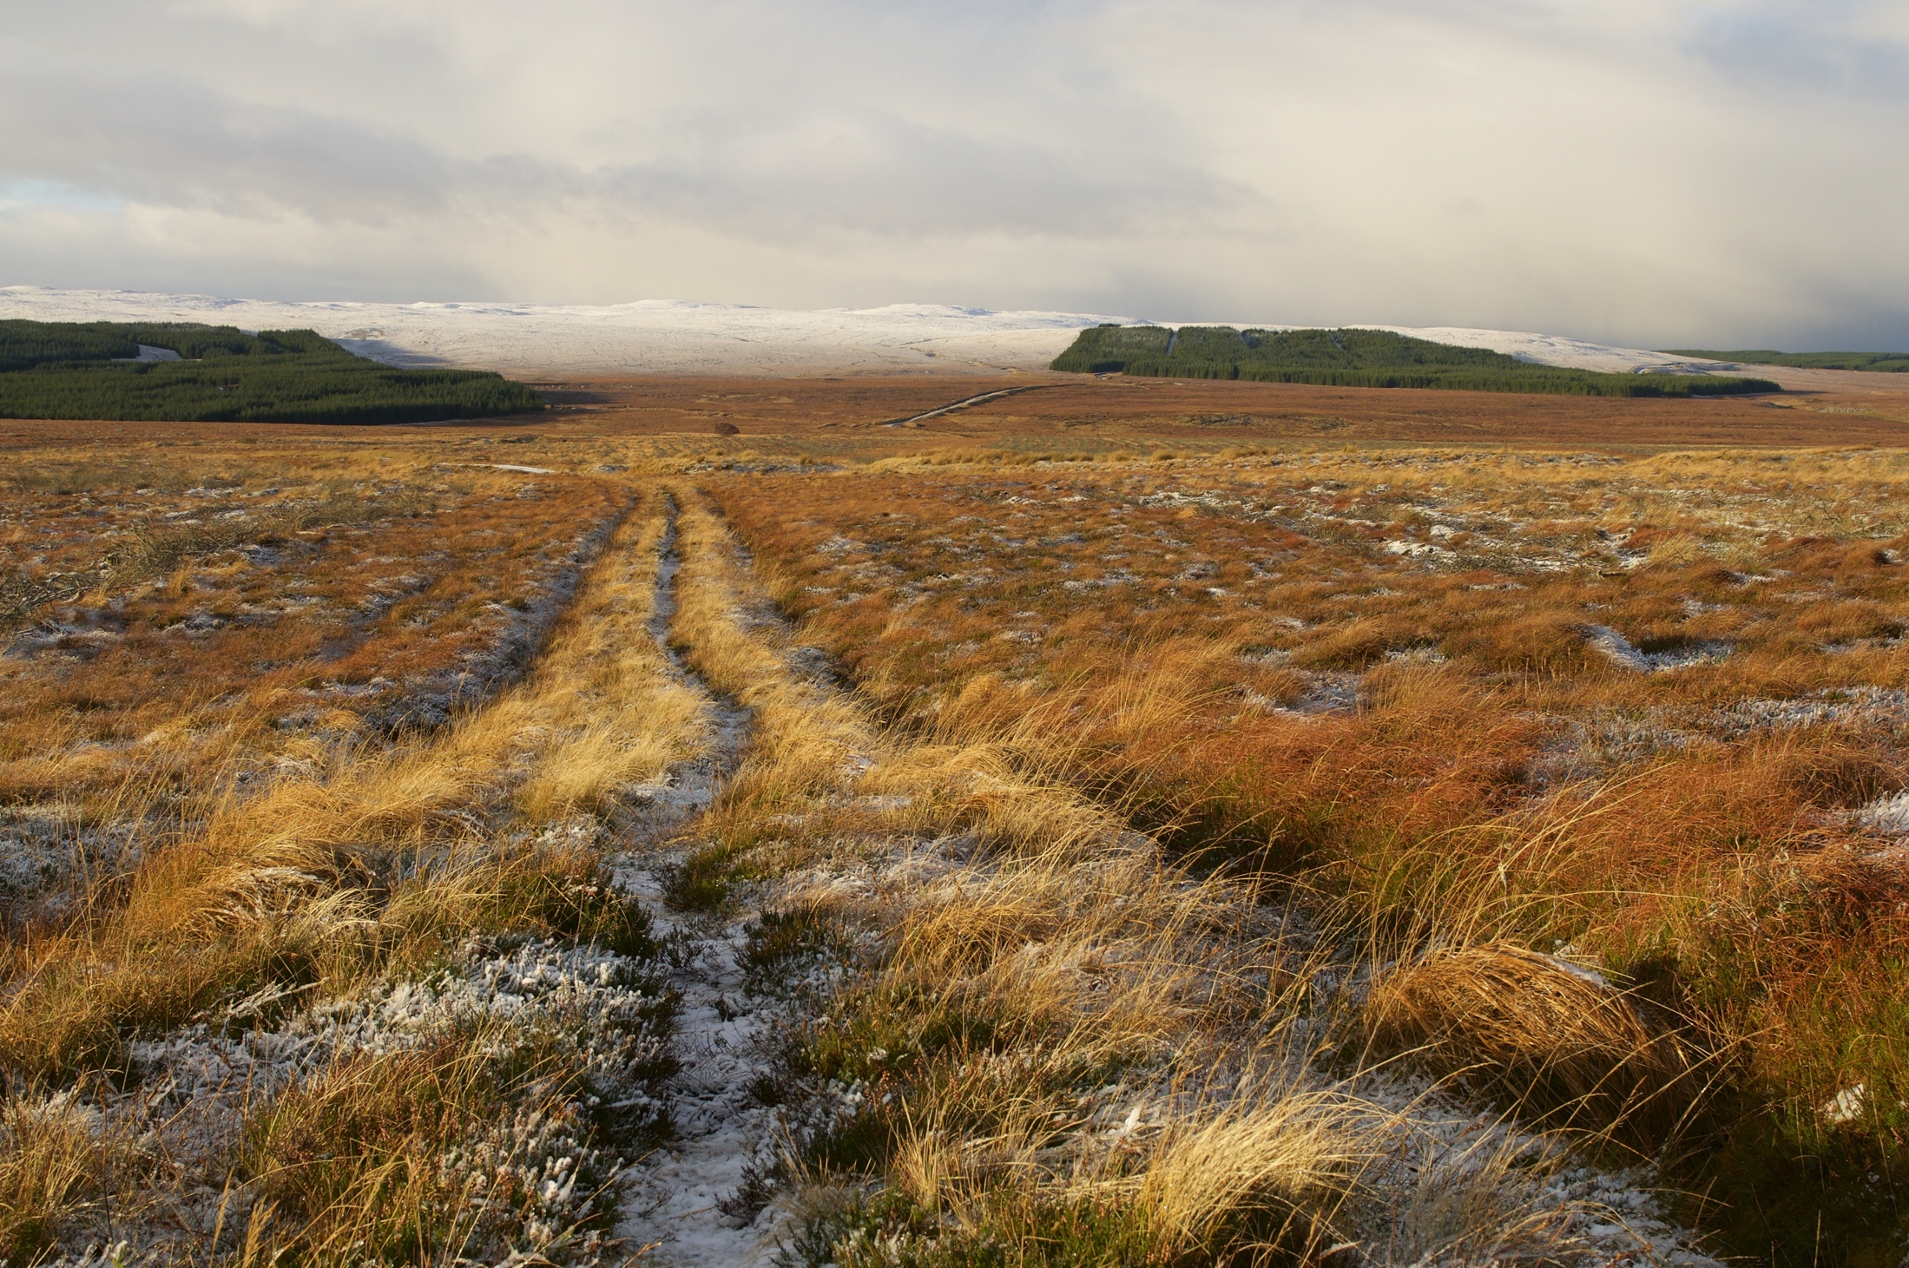
PATHWAYS TO 1.5 ^{O}C
1
Stop using fossil fuels
2
3
Reduce emissions from land use change: maintain carbon sinks & stores
Remove carbon dioxide from the atmosphere (Natural Solutions and/or Technology)
Photo credits: 1. ALAMY/The Telegraph; 2. Frontpage/Shutterstock.com; 3. Shzphoto/shutterstock.com

Slide 6
(White) =stored carbon
800 Gt CO₂
Surface: 1000 Gt CO₂
Deep ocean: 37,000 Gt CO₂
51.8 Gt CO₂
Plants: 550 Gt CO₂
Soil: 2300 Gt CO₂
Adapted from NASA 2018

Slide 7
NbS State of Play
NATURE HAS BEEN THE FORGOTTEN SOLUTION (UNTIL 2019)
25% of the problem
30% of the solution
1% of the conversation

Slide 8
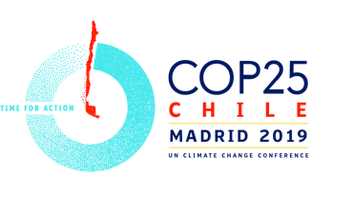
2019 Year of Major Advancement for Nature-Based Solutions
Unlocking the potential of nature in climate action
Scaling up affordable natural climate solutions
COP25 was the ‘Oceans’ COP, although the decision 1/CP.25 Underlines the essential contribution of nature to addressing climate change and its impacts and the need to address biodiversity loss and climate change in an integrated manner;
COP26 will be the ‘Nature’ COP

Slide 9
COUNTRIES WITH
REFERENCES TO PROTECTED AREAS IN NATIONALLY DETERMINED CONTRIBUTIONS (NDCs)
NDC includes specific reference to protected areas or equivalent term
NDC does not reference protected areas or equivalent
Source: Hehmeyer, A et al 2019

Slide 10
Ecosystem Contributions
INTACT FOREST LANDSCAPES
Source: Betts et al. 2017
Notes:
.

Slide 11
Primary Forests
Photos: Timothy Epp/Shutterstock.com

Slide 12
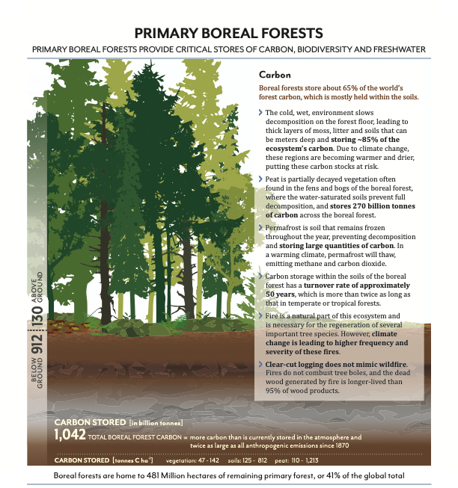

Slide 13
BLUE CARBON
(million tonnes)
For reference – Boreal forests store 1,047 billion tonnes of Carbon
Adapted from Howard et al 2017
. Photos: Divedog/Shutterstock.

Slide 14
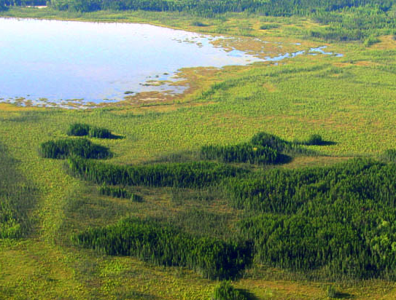
PEATLANDS
Source: Crump J. (ed) 2017
Photo: Global Forest Watch

Slide 15
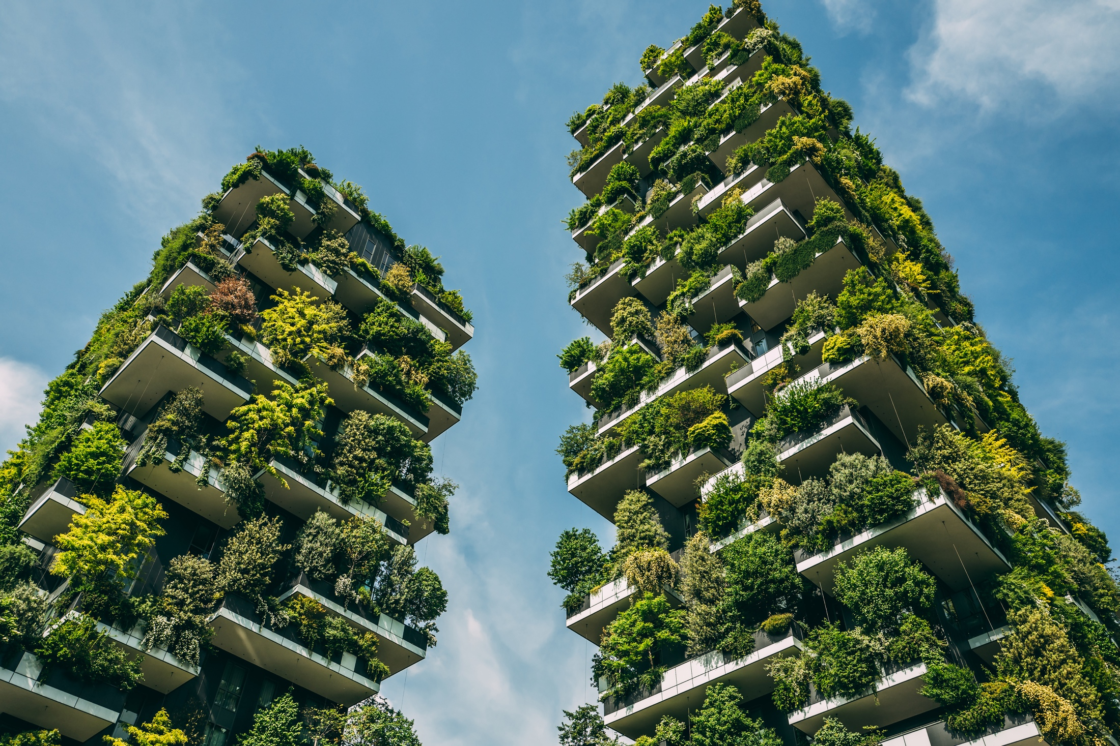
CREATIVE URBAN INFRASTRUCTURE
Photos: Sabino Parente/Shutterstock.com

Slide 16
Canada’s Approach
Proposed Priorities for
Nature-Based Climate Solutions in Canada
Expansion of protected areas networks to include carbon-dense/high biodiversity ecosystems (i.e. old-growth forests, peatlands, other wetlands, grasslands, blue carbon (saltmarshes, seagrasses)
Expansion of Indigenous Protected and Conserved Areas (IPCAs). Requires recognition of rights, land tenure, and different ways of knowing.
Expansion of protected areas networks to include mid-age (50-80 years) forests, allowing them to grow into carbon-dense/high biodiversity forests with old-growth characteristics
Significantly scaling up finance for Protected Areas, including IPCAs

Slide 17
IPCA Example
Indigenous communities
Intact forest layer
Intact ecological areas

Slide 18
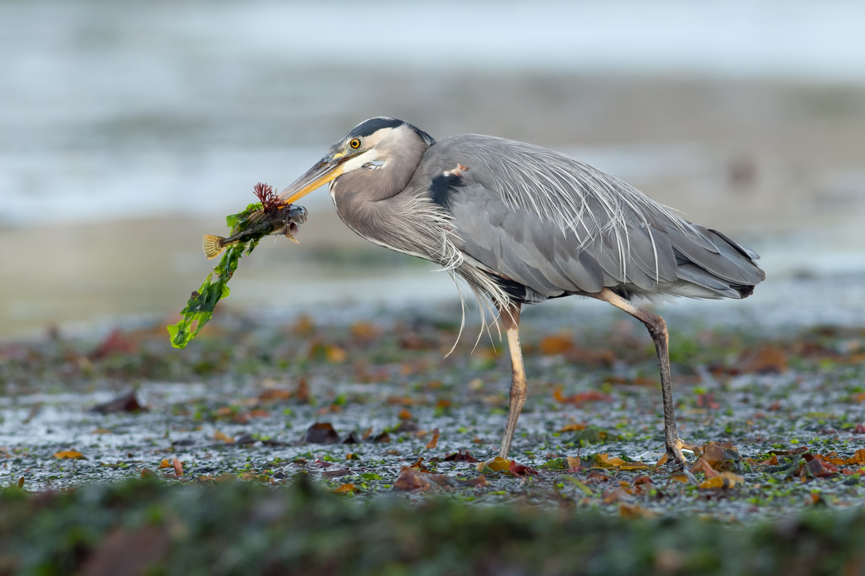
THANK YOU
Risa Smith
World Commission on Protected Areas
Protected Areas Climate Change Specialist Group
risabsmith@gmail.com
Great Blue Heron with algae & sculpin, Vancouver Island. Photo: Patagonian Stock AE/Shutterstock.

