Slide 1




IUCN Youth Champions Global Summit
IUCN World Conservation Congress,
June 11th to June 19th, 2020

Slide 2
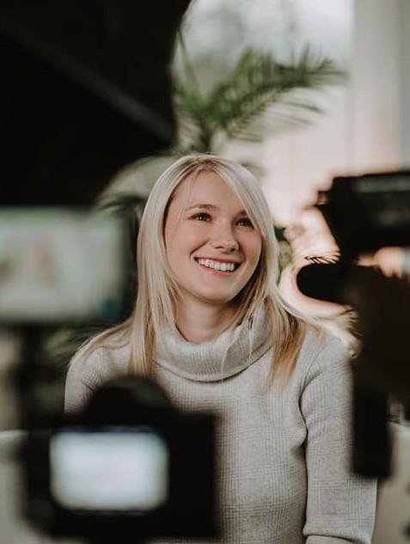
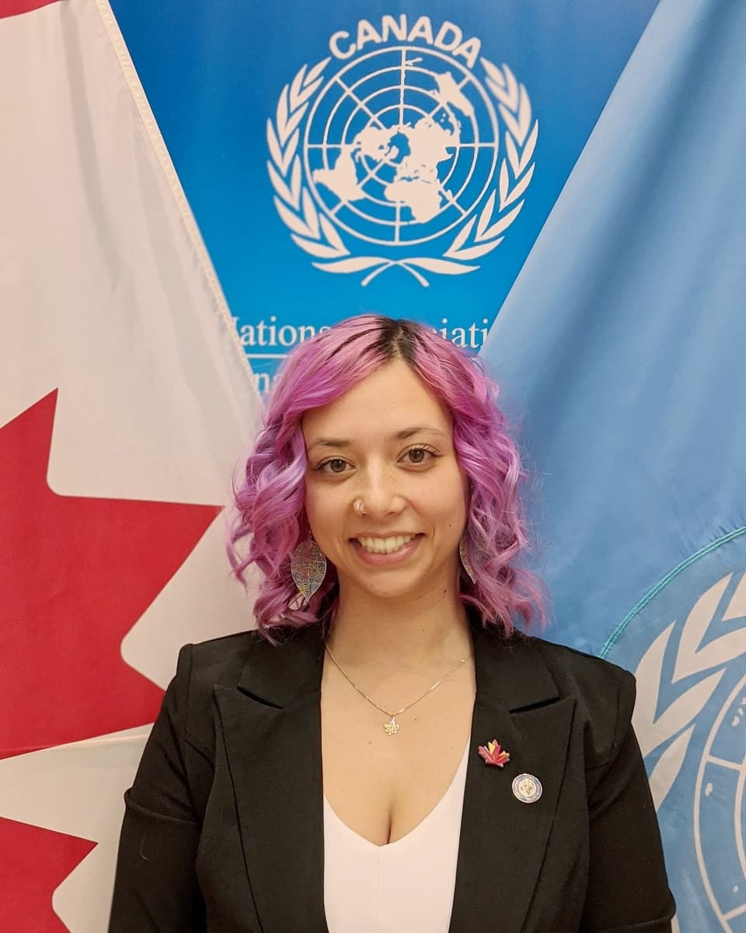
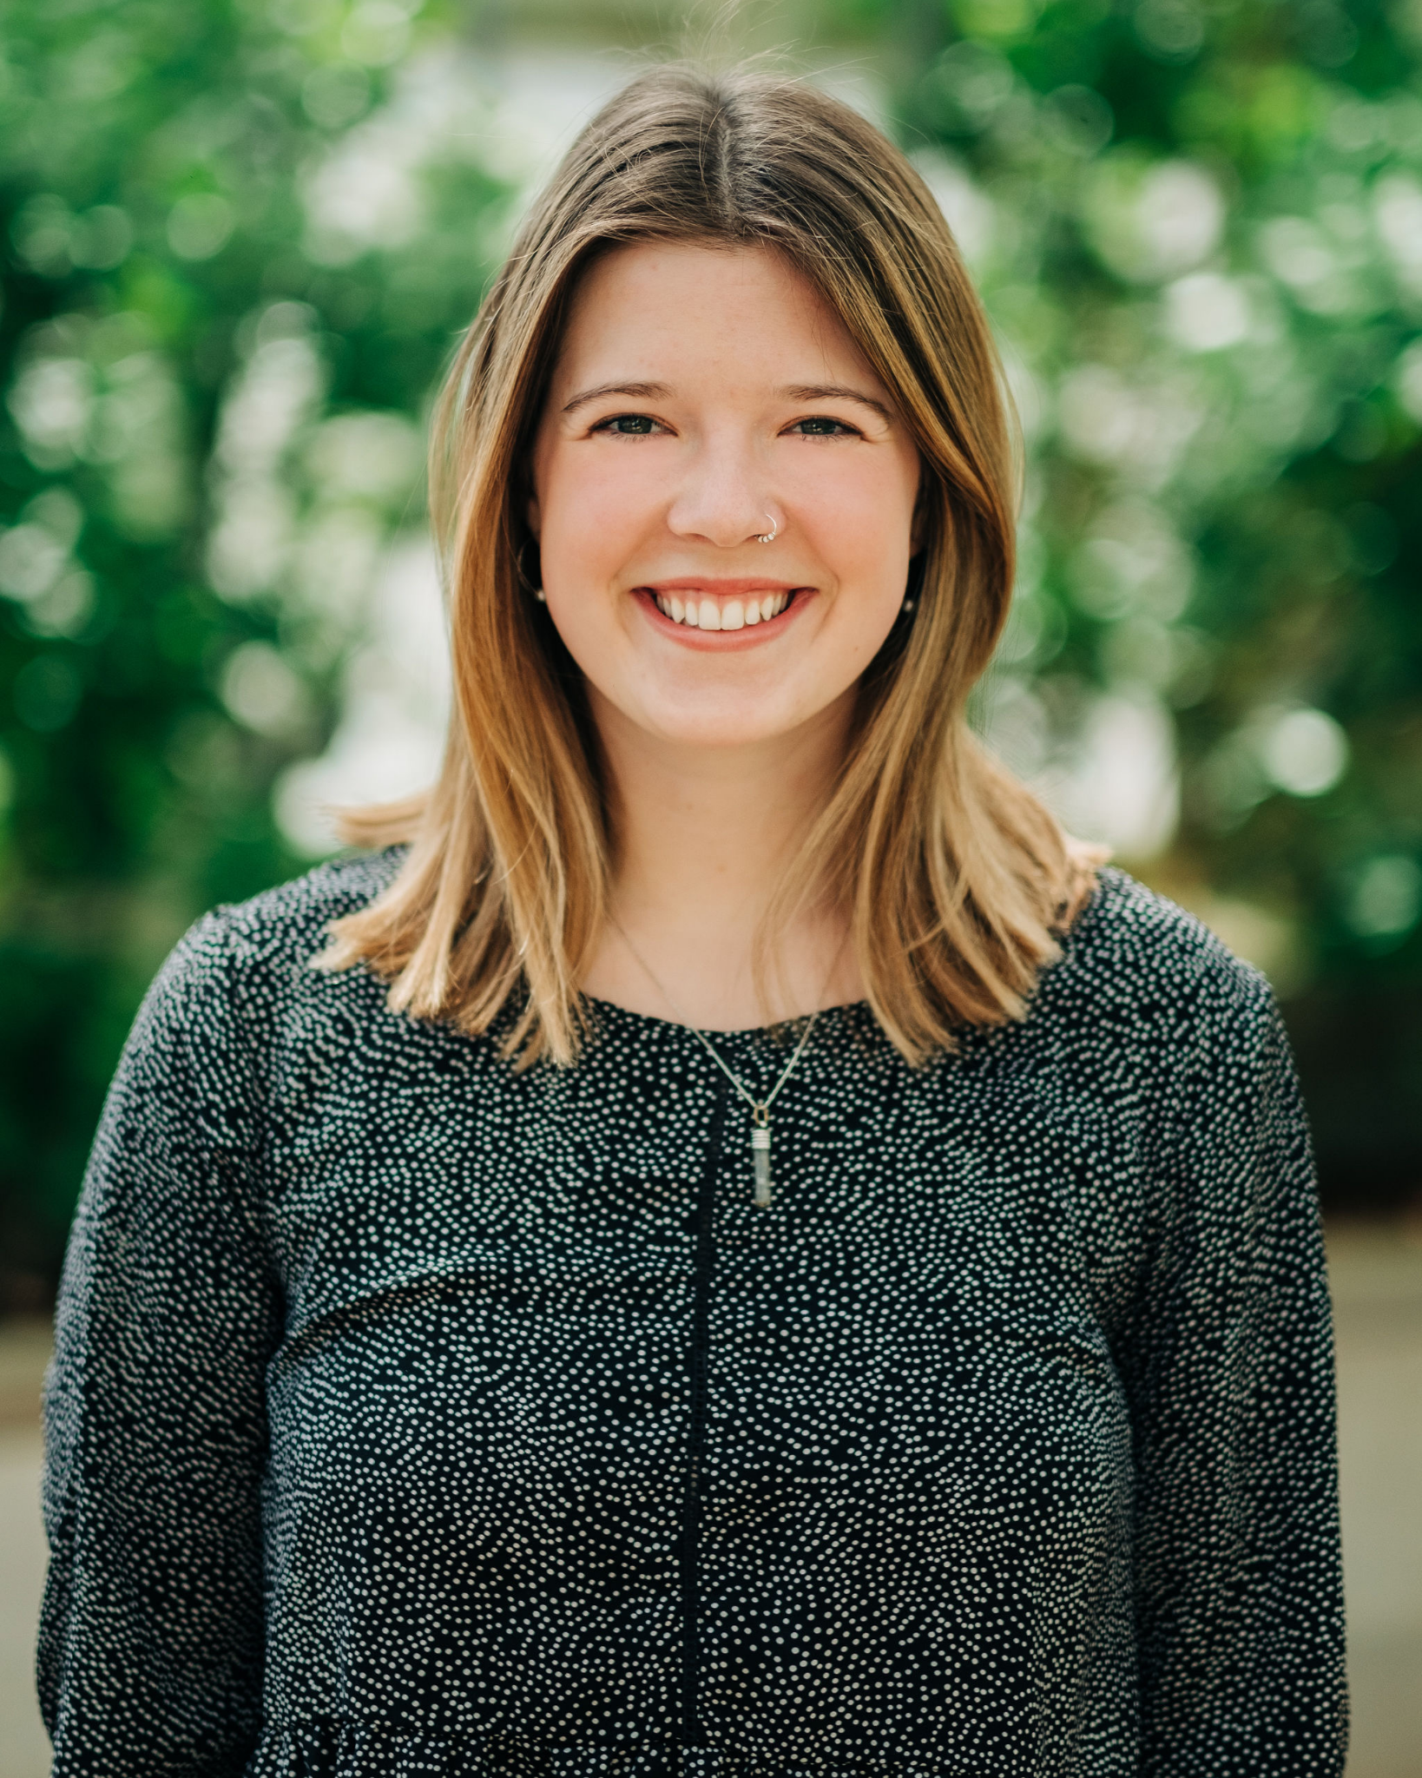
Who are we?
Caitlin Brant
Fallon Hayes
Hannah Machat

Slide 3
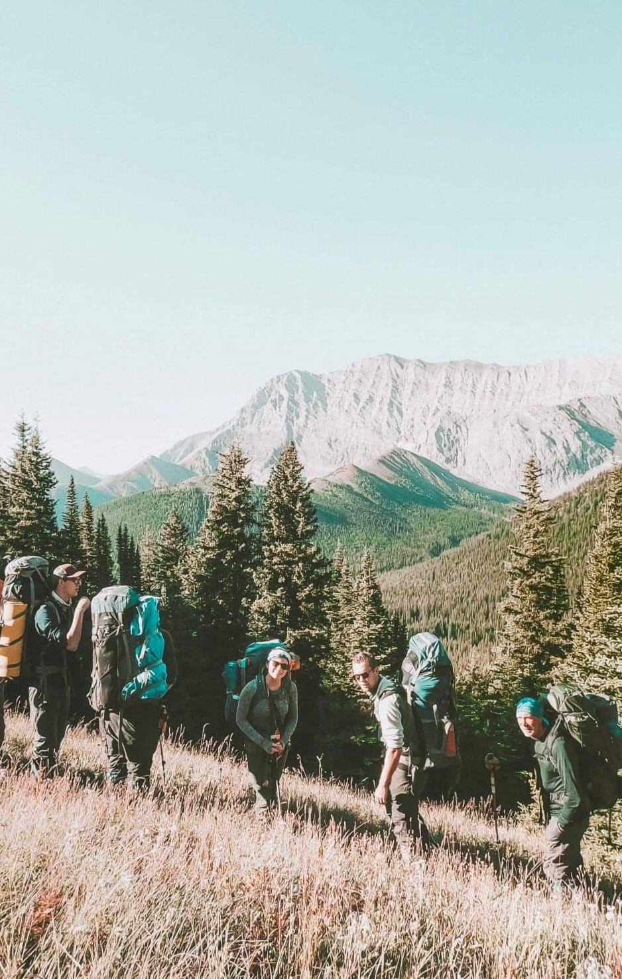

Open to ages 18-30
3 step program: adventure, immersive field learning and service project.
What is CCC?
Notes:
We are Canadian Conservation Corps participants.
The Canadian Conservation Corps is a three stage program: adventure, placement and a service project. The program is run by the Canadian Wildlife Federation under the federally funded program Canada Service Corps.

Slide 4
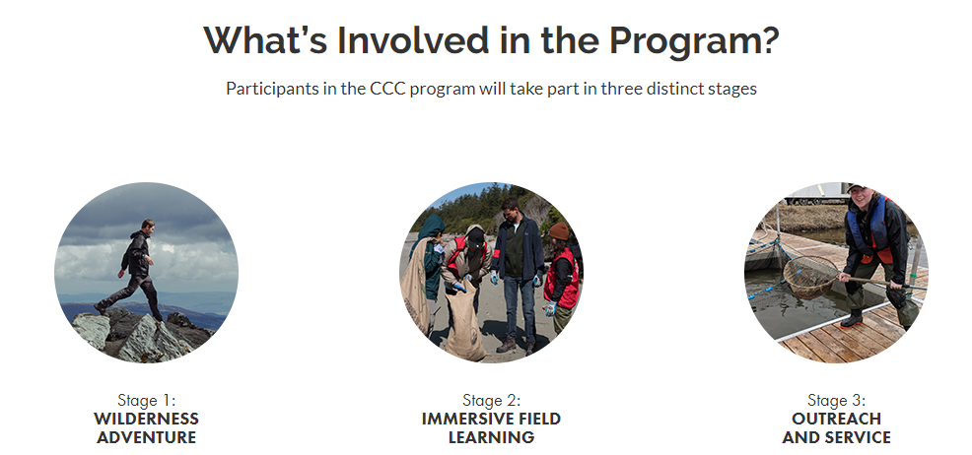
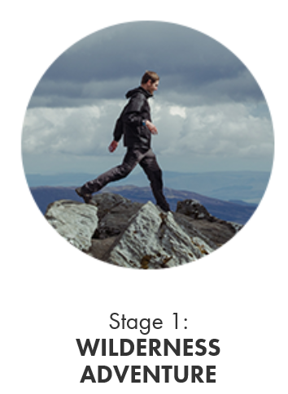
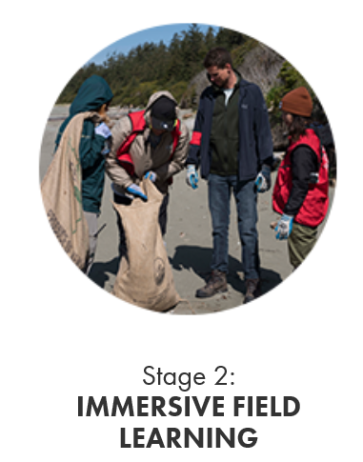
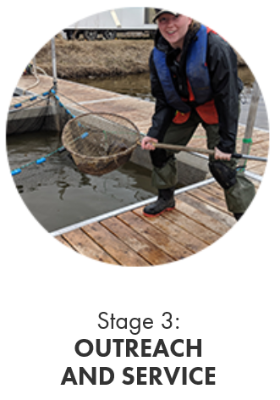

Slide 5
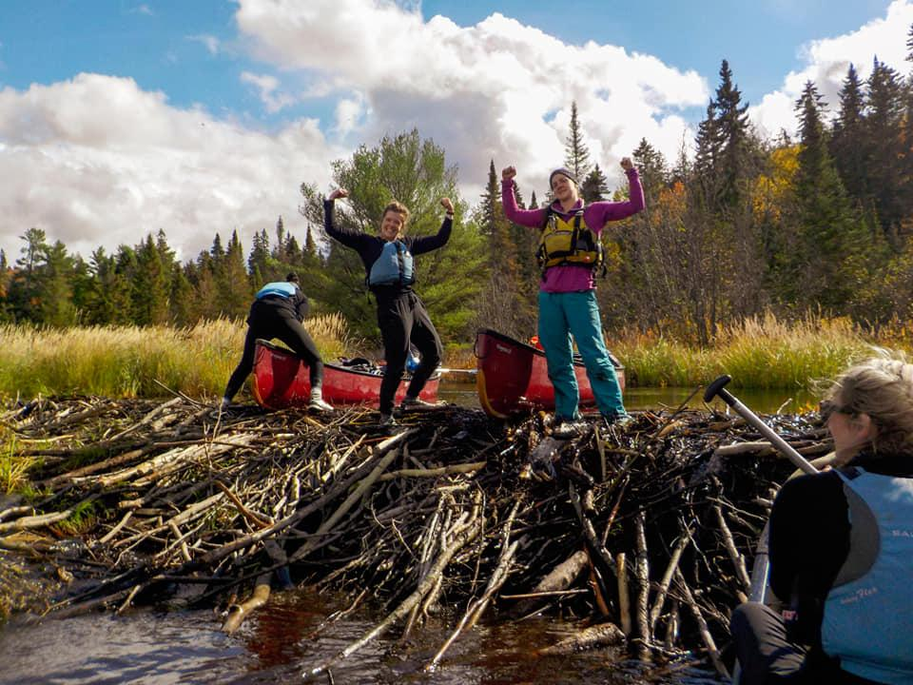
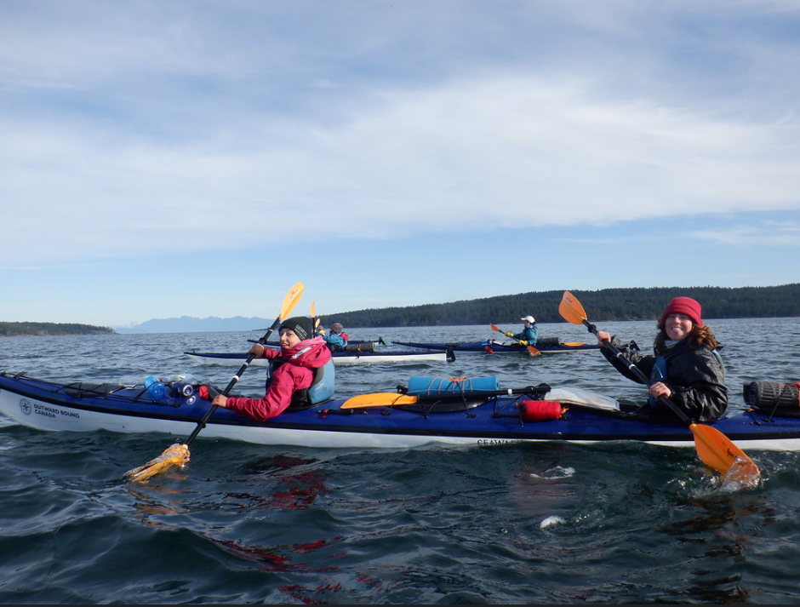
Our Stage 1:
Portaging in Algonquin Park
Sea kayaking the Southern Gulf Islands

Slide 6

Our Stage 2:
IUCN Youth Summit Coordinators

Slide 7
IUCN World Conservation Congress: Youth Engagement Summary
Youth engagement with Participants from around the world:
Youth Mainstreaming in Congress Forum
Youth Pavilion from June 12-19th
Youth Summit June 16-18th
Youth Statement at Member’s Assembly June 19th

Slide 8
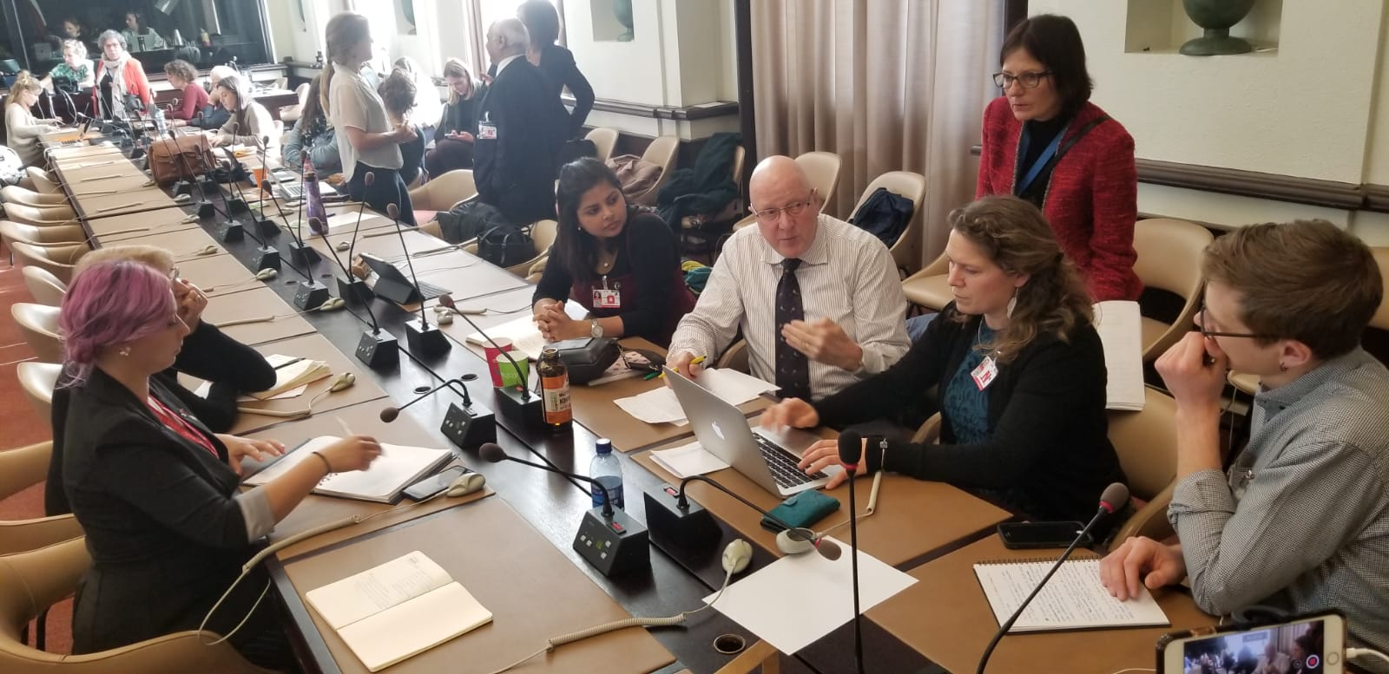
1.Youth Mainstreaming
Youth are an integral component of the entire congress, not just the Youth Pavilion and Summit

Slide 9
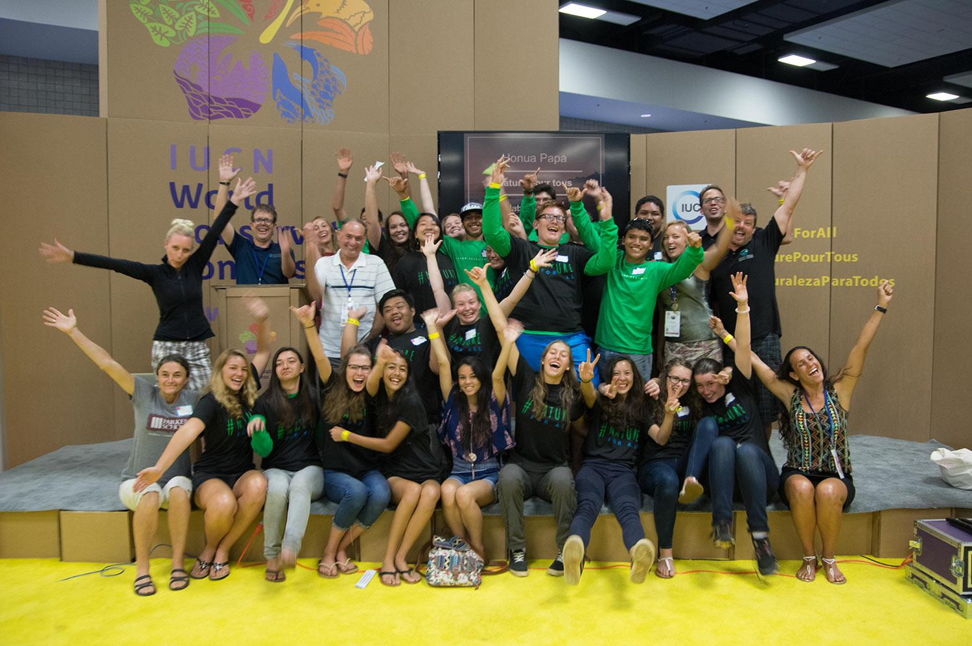
2.Youth Pavilion
Youth Pavilion
June 12th to June 19th in the Exhibition.
Public access from 9:00 am to 5:00 pm daily. Registered access from 5:00 pm to 9:00 pm.
Notes:
There will also be a youth pavilion this year! It is located in the "neutral" area of the exhibition hall.
It will be open from June 12th to June 19th and will have presentations from 10 am – 5 pm daily.
There are six themes at the pavilion that include youth presenters from around the world.
Themes:
1- Art in Nature (music, theater, visual arts)
2- Moving in Nature (yoga, dance, hiking)
3- Indigenous lifestyle (traditional knowledge, youth from remote areas)
4- Nature education (sustainability, awareness raising, action for nature)
5- Technology in harmony with Nature (apps, etc)
6- My mission is Nature (career, profession, park rangers)
We will also have food available. Please support us and visit the pavilion for interactive presentations to get your body moving like yoga.

Slide 10
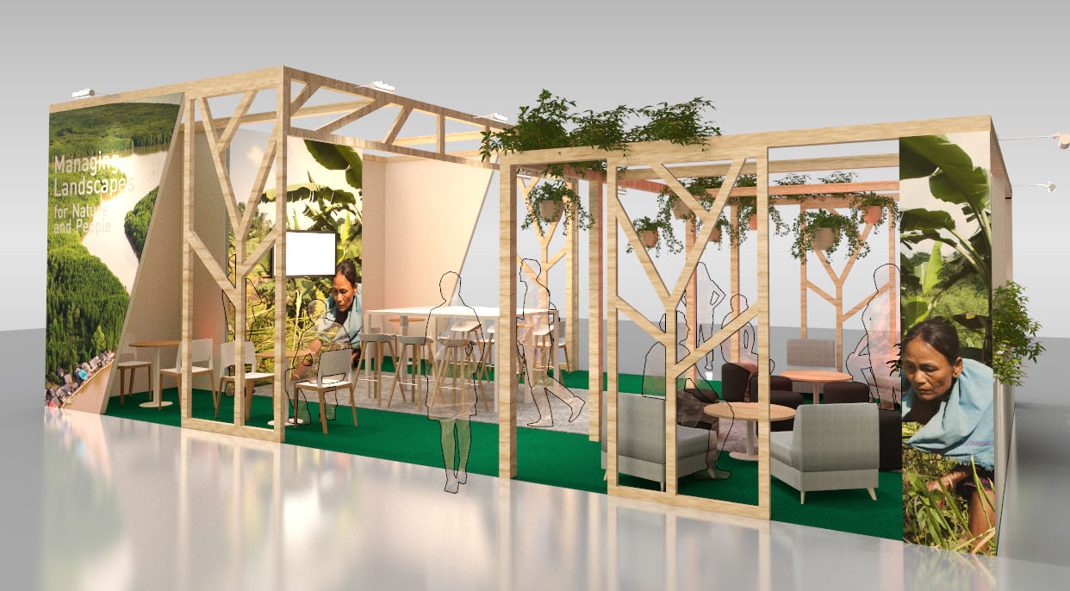
2.Youth Pavilion
Themes:
Art in Nature
Moving in Nature
Indigenous lifestyle
Nature education
Technology in harmony with Nature
My mission is Nature

Slide 11
3. IUCN's first Youth Champions Global Summit
http://natureforall.global/youth

Slide 12
Up to 400 inspiring youth and young professionals from across the world will come together.
Opening Ceremony on the evening of June 16th.
Summit runs from June 17th to June 18th.
Youth will have the opportunity to network, attend workshops and have their voices heard.
Youth Summit
Notes:
The Youth Summit is a three-day immersive event that will bring together 400 youth and young professionals from across the world. The hope is to have youth leave feeling inspired, empowered and with tools that they can then implement in their home communities.
Some of the activities we are hoping to do include: a beach clean up, workshops on how to start a movement in your community or local government, break out sessions and leadership or facilitation opportunities.
A good opportunity to discuss the work that GYBN is doing both pre-conference and post. A lot of the information that is gathered on youth engagement through the Youth Champions Summit will be influencing the CBD-COP in Kunming China. An opportunity for youth across the world to have their voices heard which will influence policy in Kunming, China.

Slide 13
4. Youth Statement to Members assembly
June 19th
Notes:
We hope to present to the Members Assembly on June 19th. We will choose exceptional youth pre-congress and have a draft statement created before the summit. Youth summit participants will have the opportunity to provide input into the draft before we present on the final day of the congress (June 19th).

Slide 14
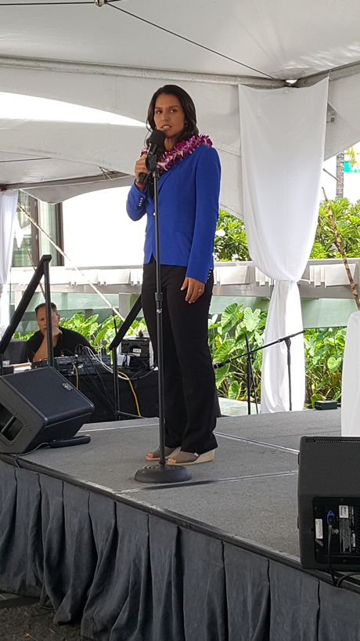
Involvement of young people (under the age of 35) from diverse backgrounds.
Active and full participation, equal to any other member at the congress.
To empower and connect youth creating a global network of conservationists.
Youth Impact
IUCN KUPU Youth Leaders in Conservation event, Honolulu, HI. User: OceanAtoll / Wikimedia Commons / CC-BY-SA-2.0
Notes:
The year 2020 has been marked as a pivotal year for biodiversity, policy that is made in the coming months will dictate changes over the next decade.

Slide 15
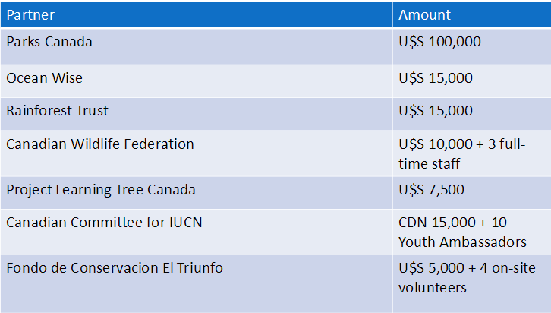
Funds raised
Notes:
Gap is about $200 000 - $250 000 for travel grant and youth summit. No amount is too small. You can fund youth directly. Looking for diverse youth from different socio-economic backgrounds, gender, etc.

Slide 16
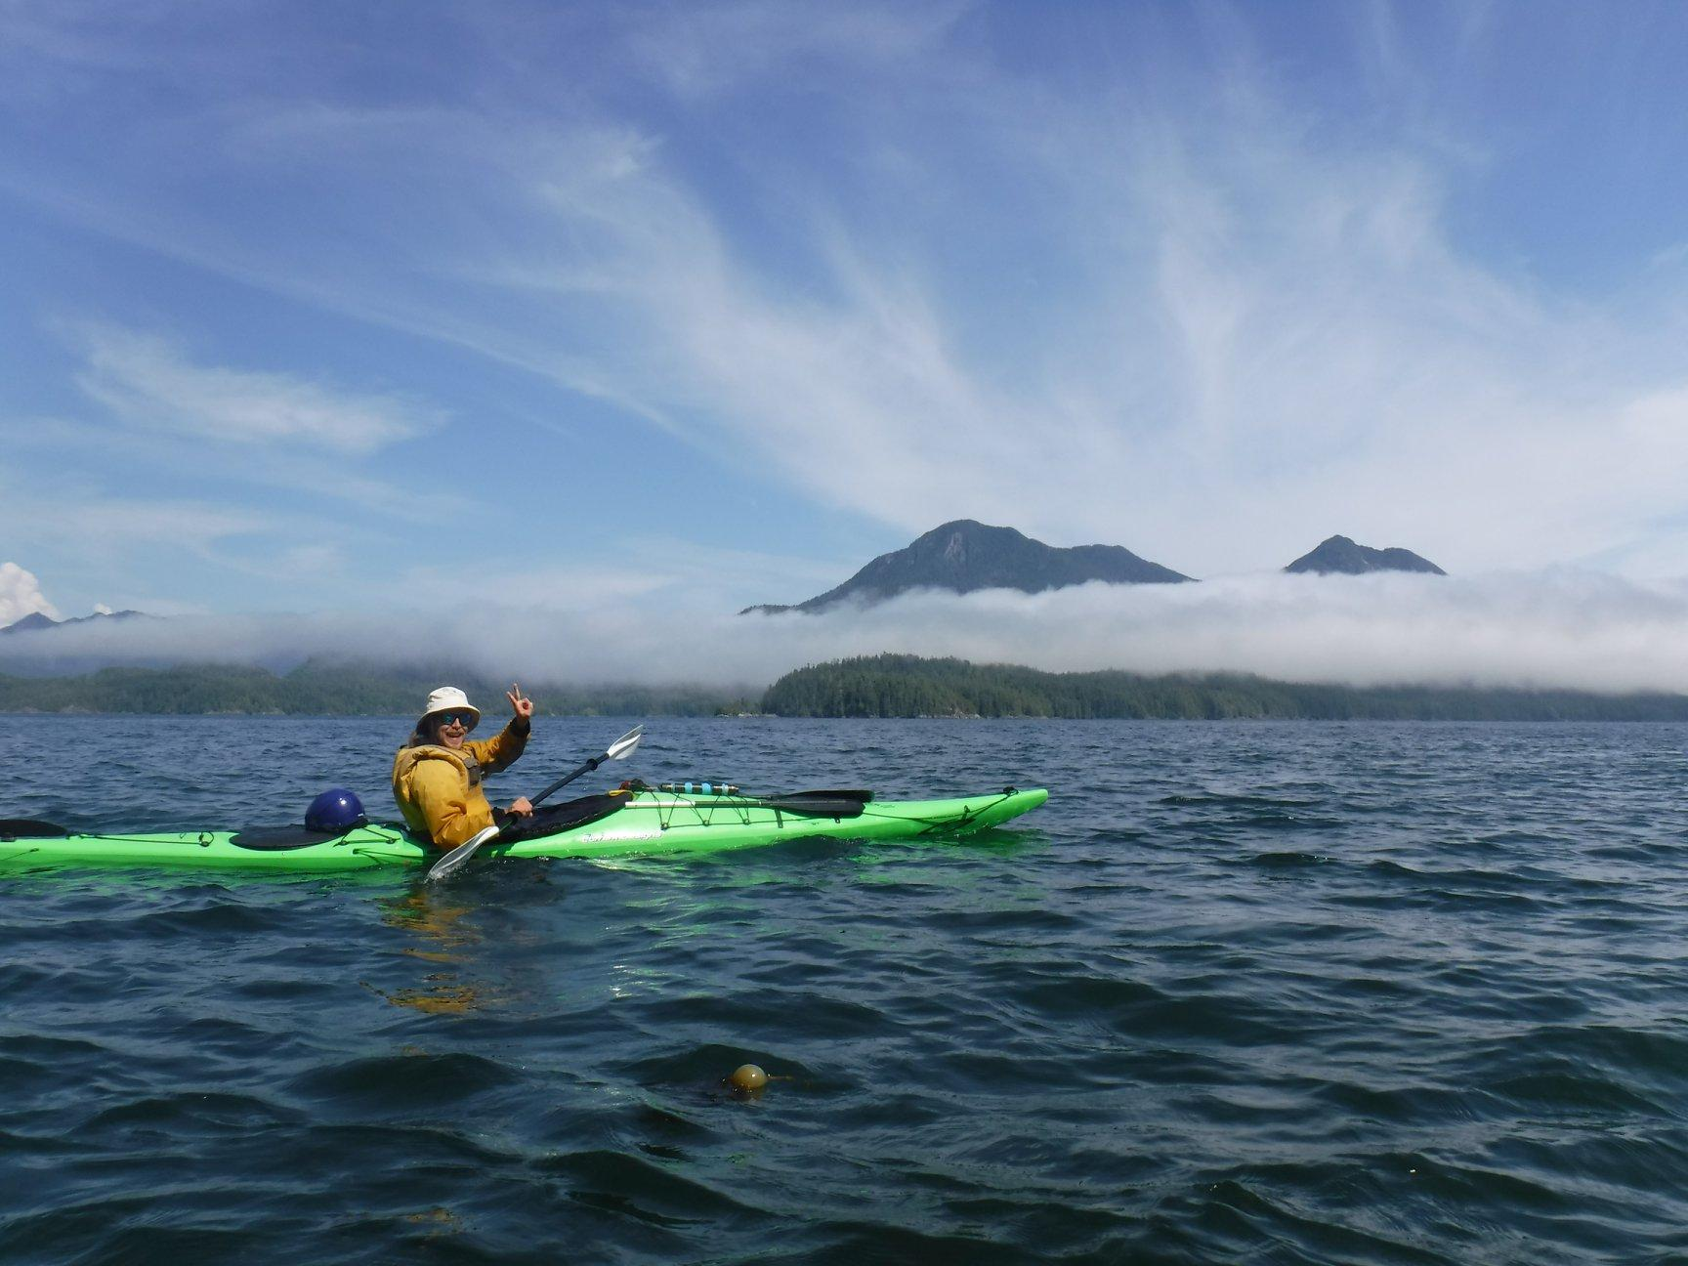
How can you get involved?
Notes:
How can you get involved in youth engagement at the Congress?
- Money, amazing youth and facilitation team
- Register youth employees (under 35) for the Youth Champions Summit or fund youth to go to the summit. Within the next week, the IUCN registration will include a Youth Summit option.
We are taking proposals
This is an exciting time for youth to be involved as it goes above and beyond with past WCC initiatives in that: The youth have the opportunity to be more fully involved in the pre-WCC work, helping to shape the process and outcomes
Participants have the opportunity to network with other youth leaders from around the world
They are part of a coordinated Canadian delegation
That's all from us. Do you have any questions?

Slide 17
Contacts
Funds: Camila and Sean, CEC IUCN
camila.perez@iucn.org and seansouthey@iucn.org
Pavilion: Caitlin, CWF
caitlinb@cwf-fcf.org
Youth Participants: Fallon, CWF
fallonh@cwf-fcf.org
Facilitation Team: Hannah, CWF
hannahm@cwf-fcf.org
SWAG Bag: Caitlin, CWF
caitlinb@cwf-fcf.org

Slide 18
Thank you!
Questions?

