Slide 1
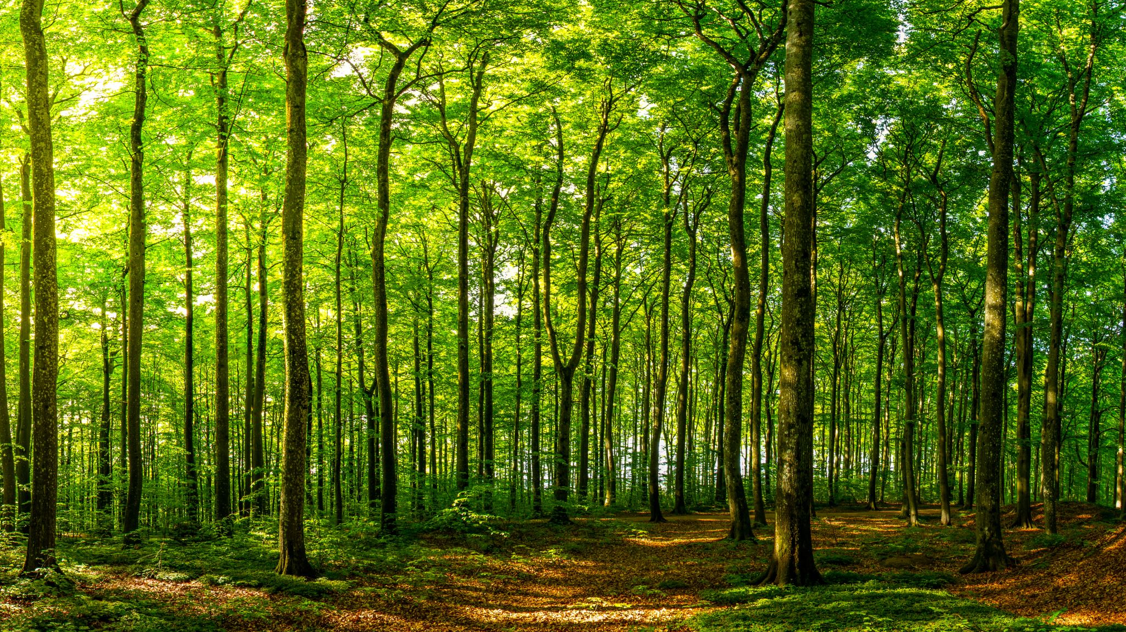

CC IUCN
Report from the communications committee
2020 AGM

Slide 2
About the committee
- Board directors and members
- Launched in 2017 to support with outreach and communications efforts
- Delivers on 3-year strategic plan

Slide 3
2019-2020 Action plan
Goal 1: Increase awareness of CC IUCN and IUCN efforts in the conservation community
- Website updates
- Tools for conferences/events

Slide 4
2019-2020 Action plan
Goal 2: Improve communications with CC IUCN membership
- Listserv (CC IUCN Discussion Group)
- Content calendar

Slide 5
2019-2020 Action plan
Goal 3: Support CC IUCN priorities and committees with communications efforts
- Biodiversity Communications
- #NatureForAll
- Youth Ambassadors
- Membership Committee

Slide 6
How to get involved
- Join the committee
- Send us ideas for content
- Be in touch with general feedback

Slide 7
Thank you!
cciucn@nature.ca

