Slide 1
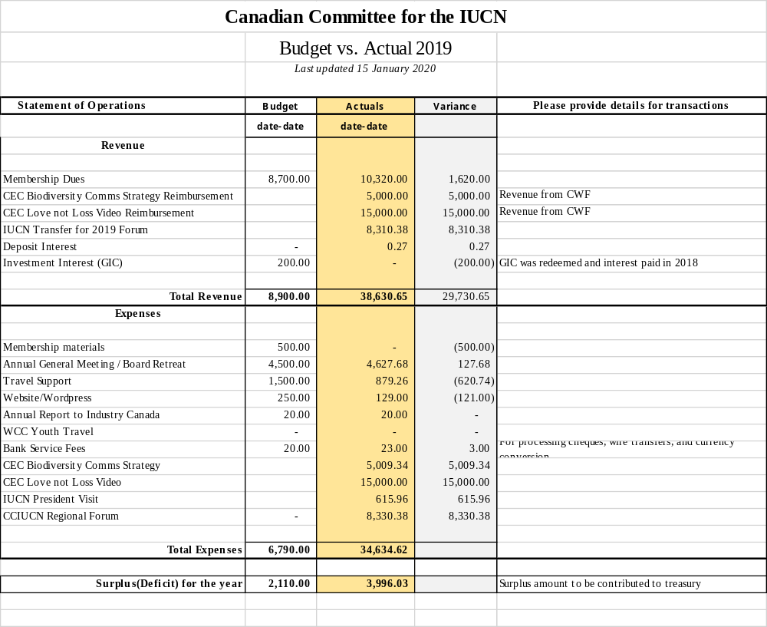
Treasurer’s Report for 2019

Slide 2
Treasurer’s Report for 2019
 | Canadian Committee for the IUCN
 | Balance Sheet
 | As of 31 December 2019
Assests
Bank Balance (Dec 31st, 2019) | 29,241.41
Total Assets | 29,241.41
Liabilities
IUCN Grant Payback | 4,548.62
Total Liabilities | 4,548.62
Net Balance | 24,692.79

Slide 3
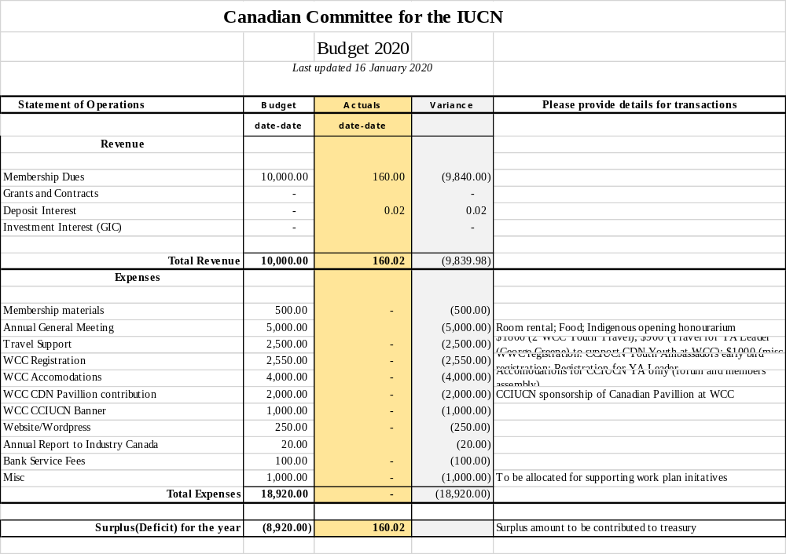
Treasurer’s Report for 2019

Slide 4
Strategic investments for the 2020 budget
Youth ambassadors at WCC
  Registration
  Travel
  Accommodation
IUCN WCC Canada Pavilion
  Visual Presence
  Collateral
  Personal presence through CCIUCN board members attending WCC and youth ambassadors

